Slide 1
PRESENTATION OF THE SCHOOL’S 50th ANNIVERSARY CELEBRATION.

Slide 2
1. Short story of our school:
1961 – A cornerstone laid in Szkolna Street for the construction of the new primary school.
1963 - 1026 pupils start learning in a newly opened school which is given the name of a famous Polish Large Shipping Captain – Mamert Stankiewicz.
1982 – A new pavilion is added to the main building
1983 – The school is given a banner by the representative of the Department of Education.
2013 – The 50th anniversary of our school !!!

Slide 3
2. Meetings with retired teachers.
During the anniversary celebration we met a few retired teachers. They told us some interesting facts from the history of our school.
Here there are:
If students misbehaved, special letters were sent to their parents’ work place. Sometimes parents had to pay a fine because of their child’s misbehavior!
At the very beginning of our school, during winter time students had to put some coal to the school fire place as there was no central heating.
Toilets were situated outside the school building.
Marks given were only: 2, 3, 4, 5. The were no marks 1 and 6.

Slide 4
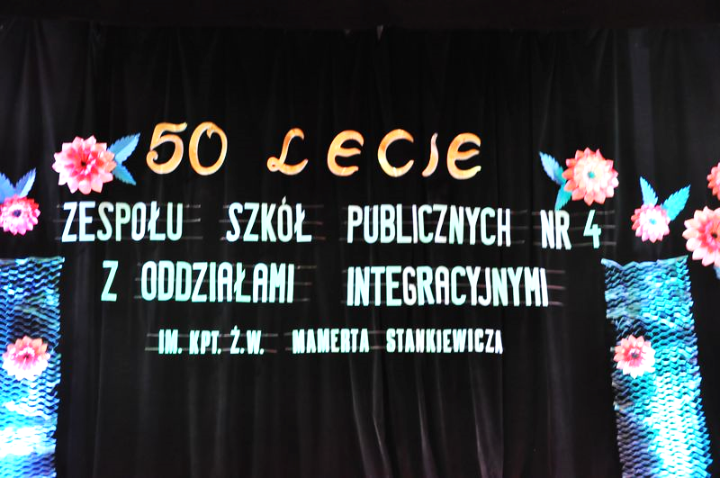
3. Solemn celebration of the 50th anniversary.
On 26th October 2013 an official celebration was held at the town hall, to which were invited, among others, the President of Świnoujście, the Chairman of the Town Council and representatives of the Rotary Club. A scenario for the celebration was created by Mrs Bernardetta Kołdunek.

Slide 5
The Principal`s speach.

Slide 6
The school choir singing.

Slide 7
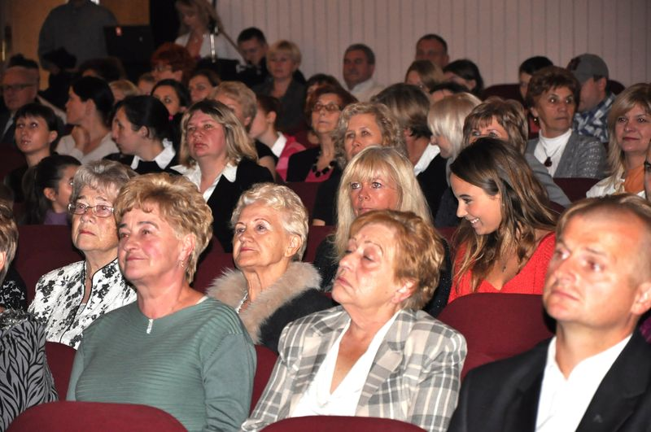
Large and happy audience… :o)

Slide 8
Congratulations !!!

Slide 9
Mr. Mrozek`s speach.

Slide 10
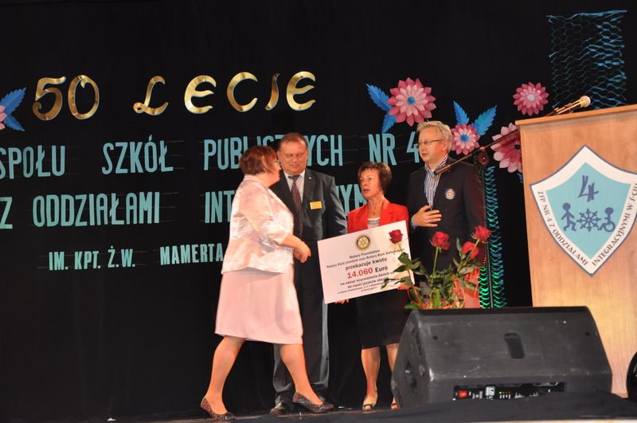
Checque for a language room equipment from Rotary Club.

Slide 11
We love German
language :o)

Slide 12
Wanesa Warwas dancing with her partner.

Slide 13
Yeah! Yeah!

Slide 14
Welcome to the programme: „The page of history”.

Slide 15
Dominika and Dawid dancing.

Slide 16
We are the champions!

Slide 17
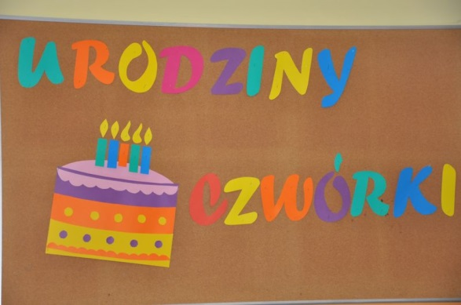
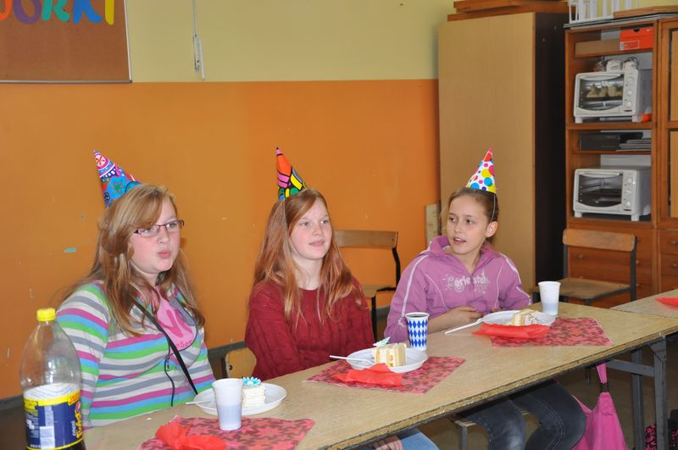
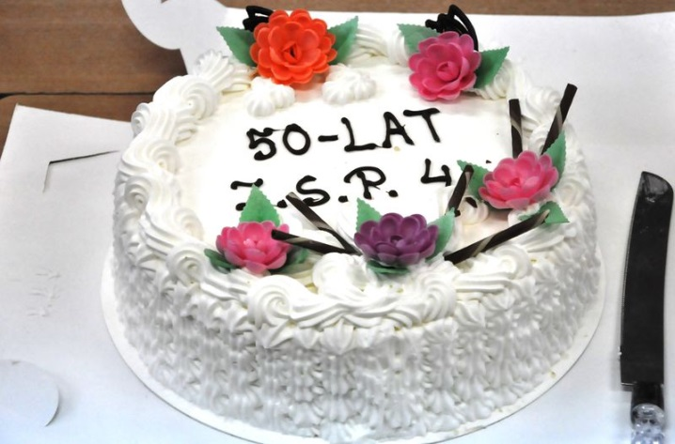
4.Celebrations in the classrooms.
On the day of the anniversary each class had a day off from lessons and celebrated the feast of our school.

Slide 18
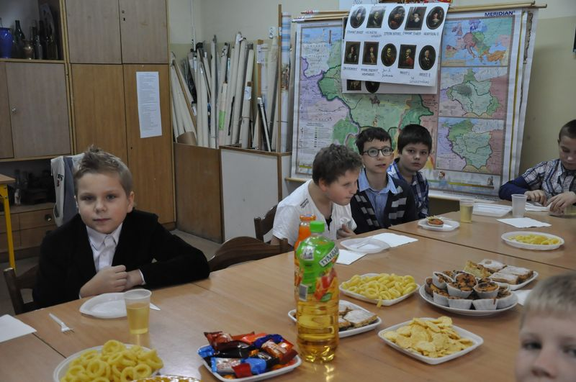
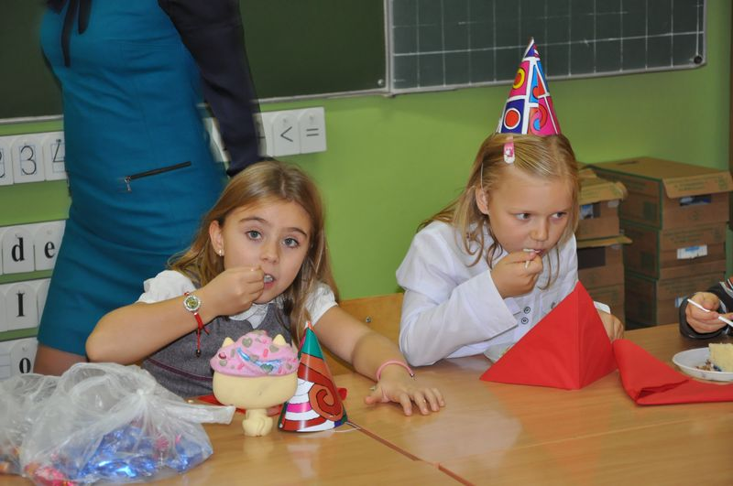
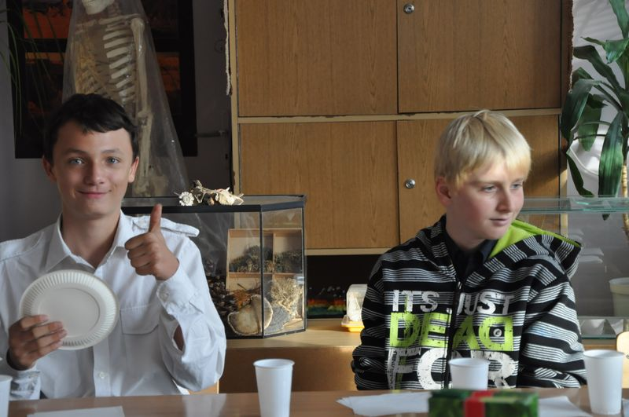
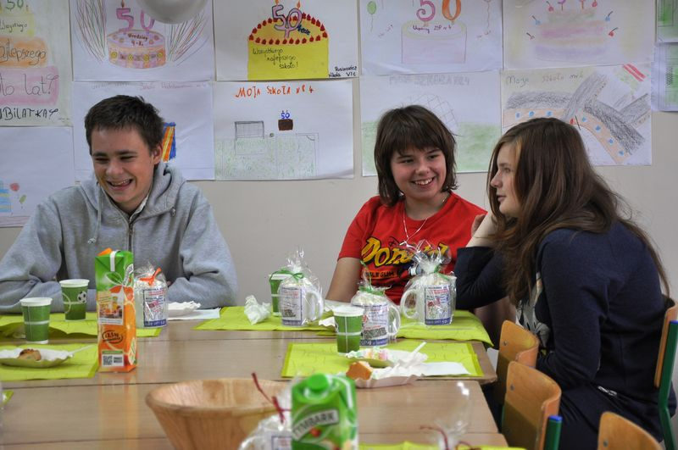

Slide 19
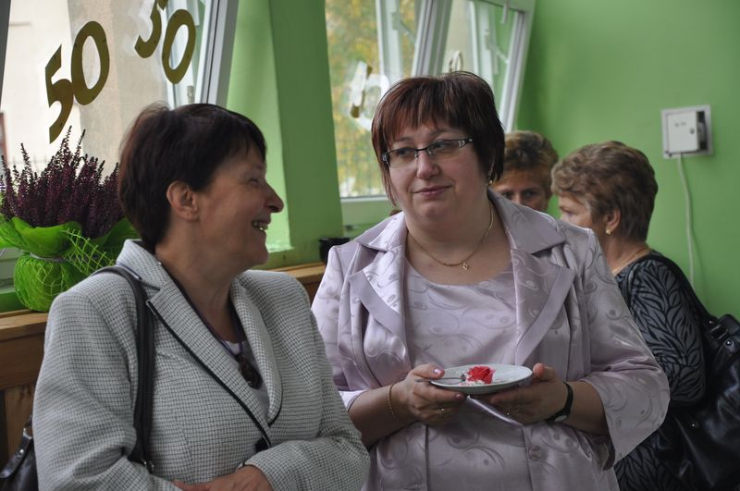
5. Events at the school building.
There was an opportunity for everyone to visit the school building and see the art works of students, multimedial presentations, chronicles and photos from the history of our school.

Slide 20
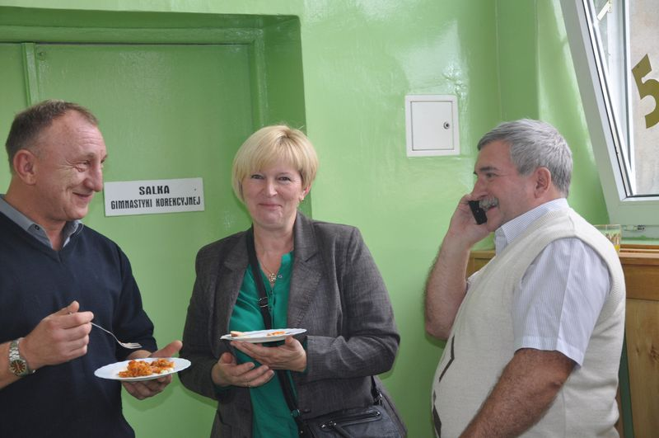
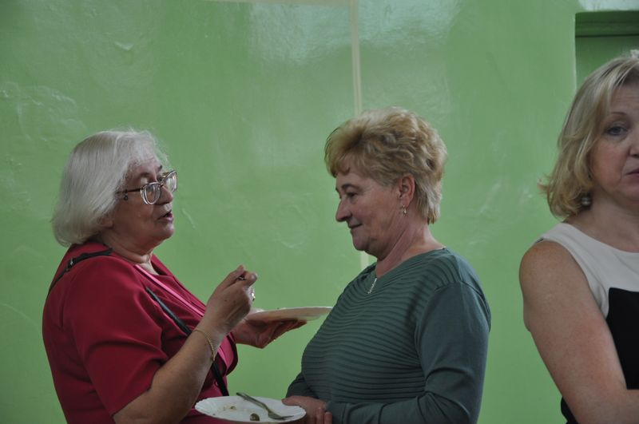
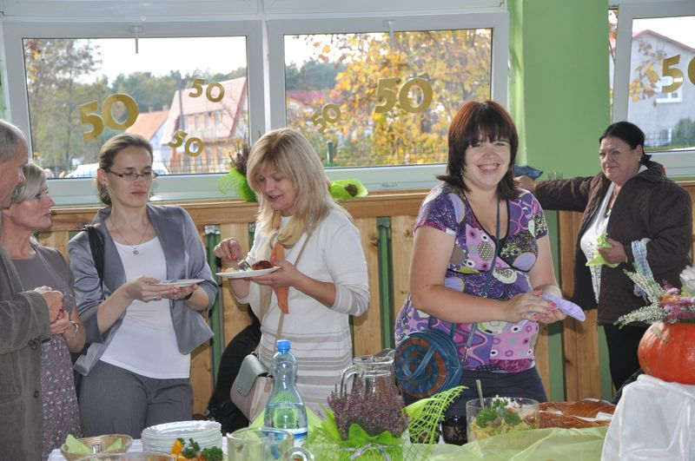
Banquet… yummy… :o)

Slide 21
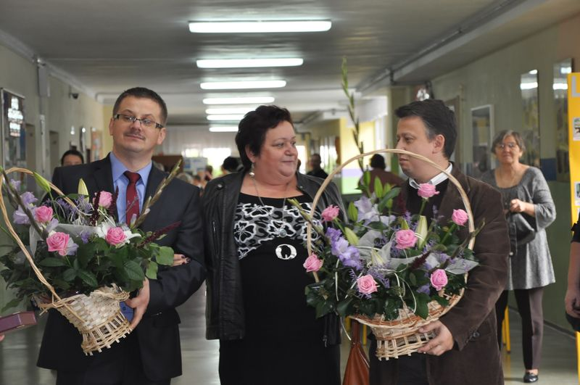
Two boys, two bouquets and one woman...

Slide 22
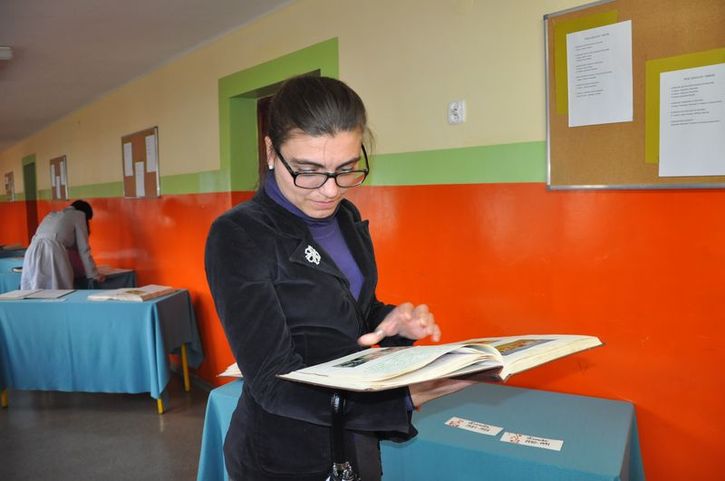
School`s chronicles are so interesting…

Slide 23
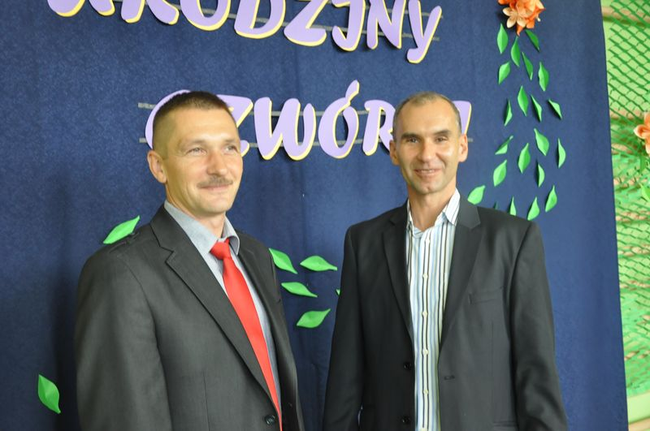
A smile for the camera… ;O)

Slide 24
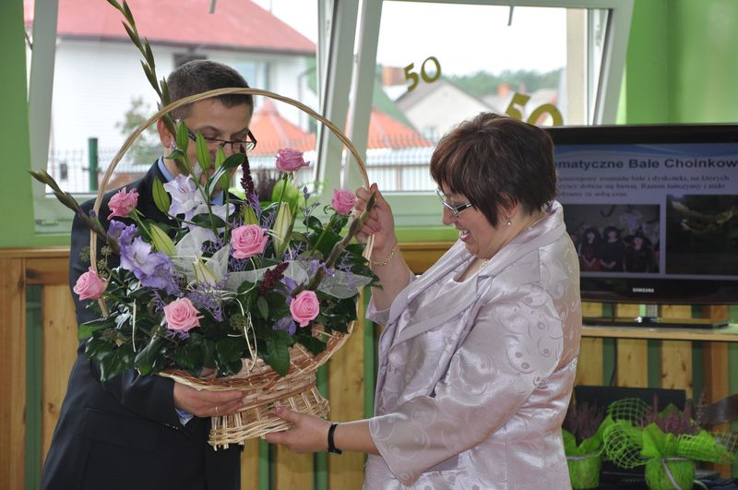
They’re so beautiful…

Slide 25
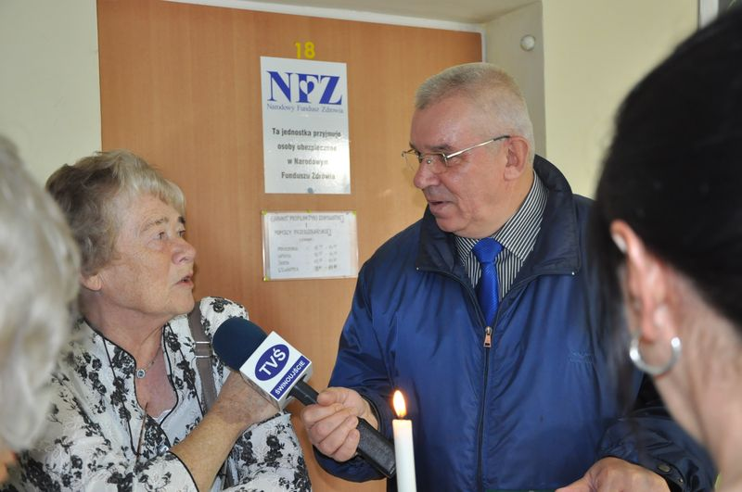
An interview…

Slide 26
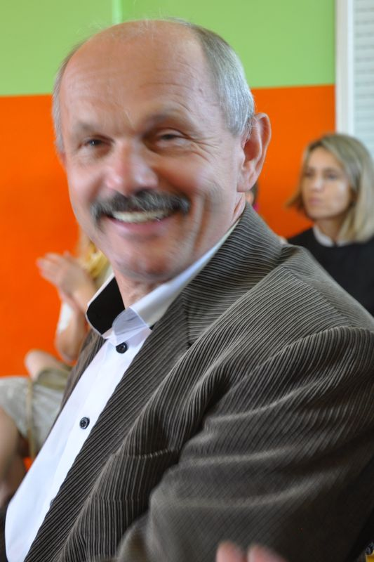
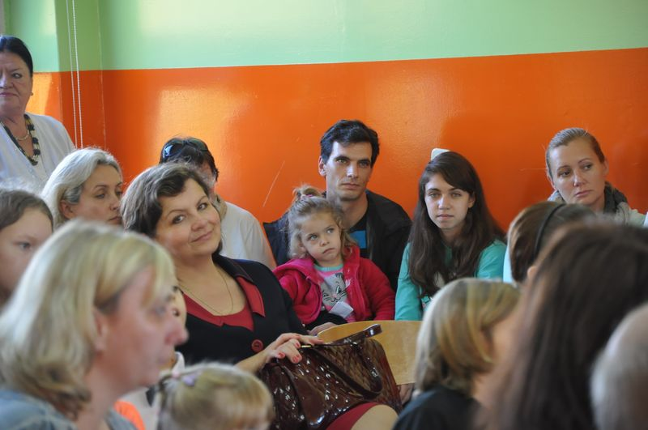
6.„Talenciak” contest.

Slide 27
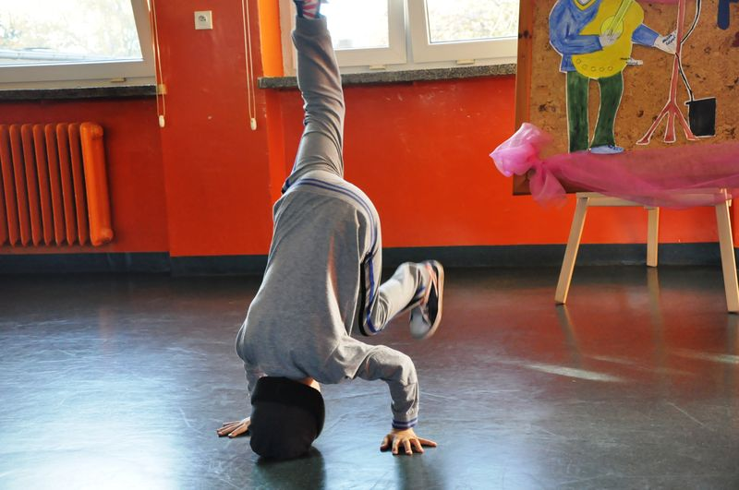
Adrian Okoński (Id) dancing hip – hop.

Slide 28
Paulina Pisarkiewicz (IIc) singing „Budzik”.

Slide 29
Wiktoria Sczepańska (IVc) – the cabaret.

Slide 30
Dalia Przetacznik and Piotr Dębicki (IIIc) dancing: samba, cha – cha und English waltz.

Slide 31
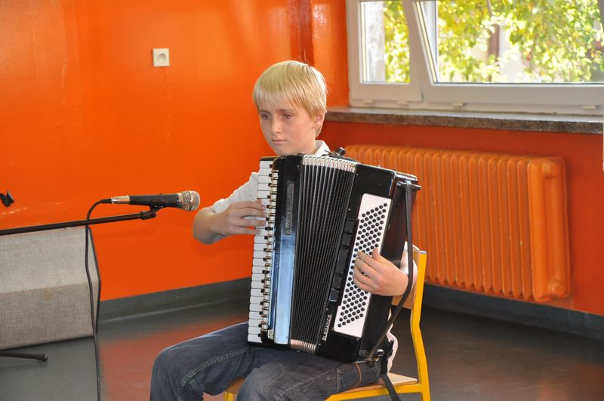
Andrzej Dębicki (VIc) playing an accordion.

Slide 32
Wiktoria Białek (Va) singing „Zakazany owoc”.

Slide 33
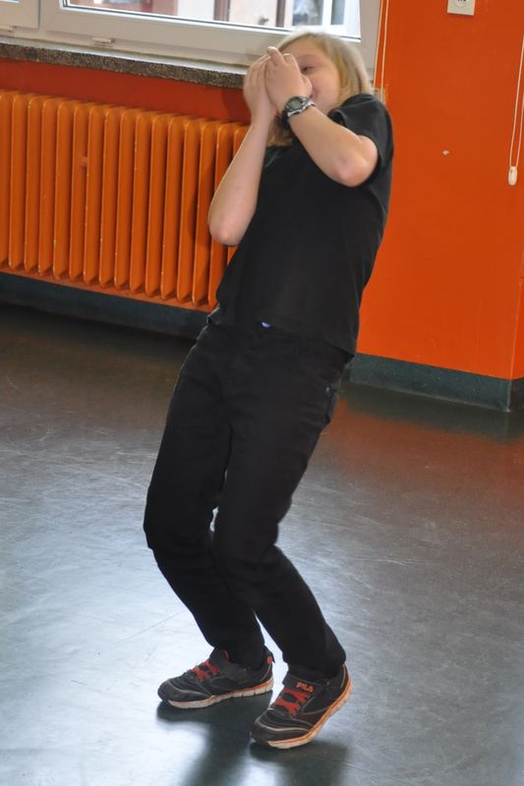
Piotr Szaciłowski (Va) – a mime.

Slide 34
Sonia Dorula (IIIa) singing „Rolling in the deep”.

Slide 35
Oliwia Jasek (VIc) and Dawid Augustin (VIa) dancing.

Slide 36
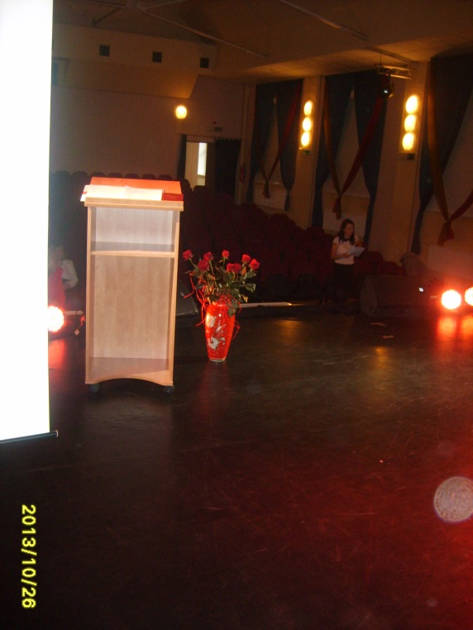
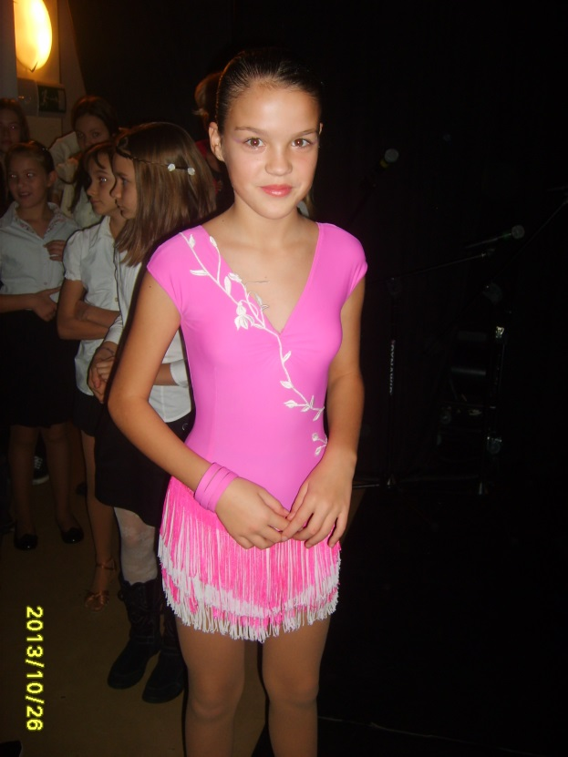
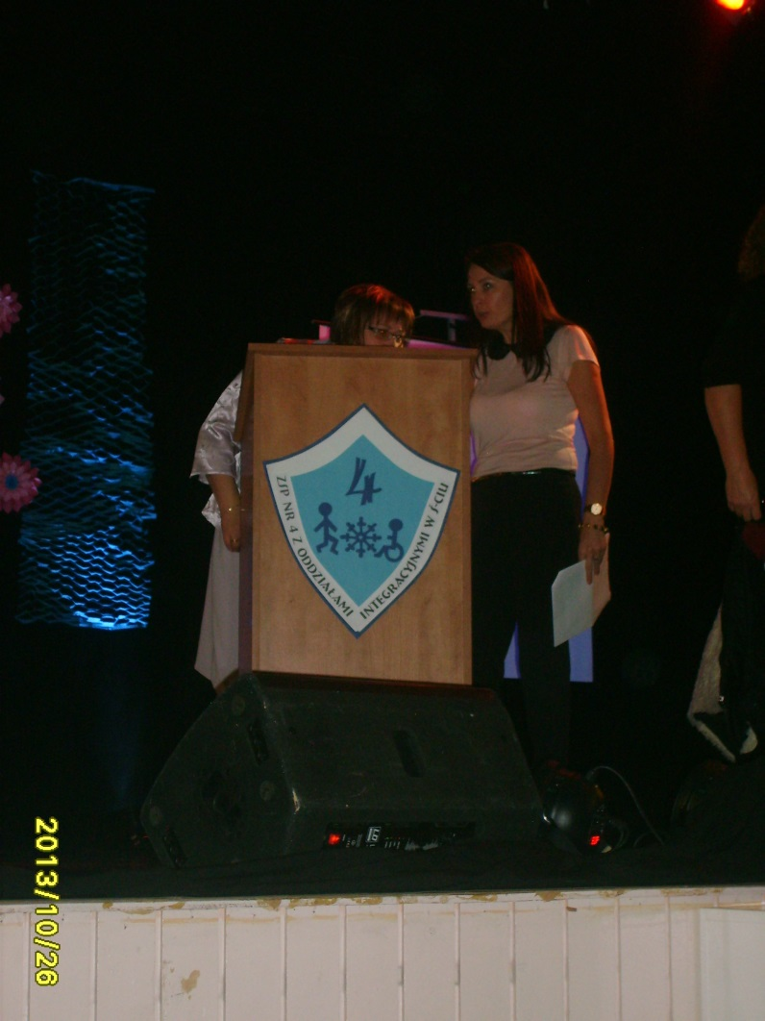
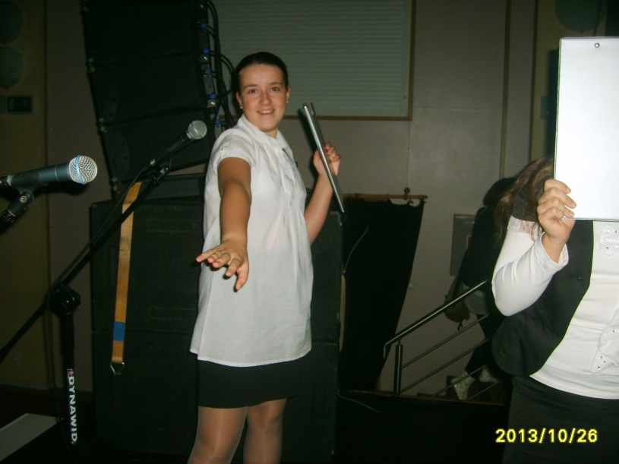
7. At the backstage.

Slide 37
A multimedial presentation was made by:
Katarzyna Kulikowska,
Iga Kuśmierczyk,
Dominika Poppel.
supervised by
Mrs Regina Jankowska

Slide 38
THE END.

